Slide 1

Major Project-II (CA401P) Even Semester Session 2025-2026
Get Prep
Tarun Kumar – 202410116100223
Tushar Kumar – 202410116100227
Vaibhav Singh Kalura – 202410116100233
Vishal Dagar - 202410116100249
Project Supervisor:
Dr. Amit Kumar Gupta
Ms. Anita Yadav
Dr. Neelam Rawat
Project Incharge :
Dr. Ankit Verma
Ms. Annu Yadav

Slide 2


The Problem with Today's Interview Prep
What's Missing
The Result
Candidates walk into interviews underprepared, misaligned with what companies actually test — and confidence suffers.
No Personalization
Generic content fails to align with specific roles or company expectations.
Poor alignment between preparation and actual company expectations remains the #1 gap in modern interview platforms.
No JD Analysis
Platforms ignore Job Descriptions — the single most important signal for interview prep.
No AI Evaluation
Candidates receive no meaningful scoring or improvement guidance.

Slide 3
Our Objectives
A five-pillar mission to transform how candidates prepare for interviews.
AI-Driven Platform
JD Analysis
Personalized Questions
Build an end-to-end AI-powered interview preparation system.
Parse uploaded Job Descriptions to extract required skills and competencies.
Generate tailored technical, HR, and coding questions per role.
Automated Scoring
Readiness Boost
Deliver real-time feedback, scores, and improvement suggestions.
Improve candidate confidence through realistic interview simulations.

Slide 4
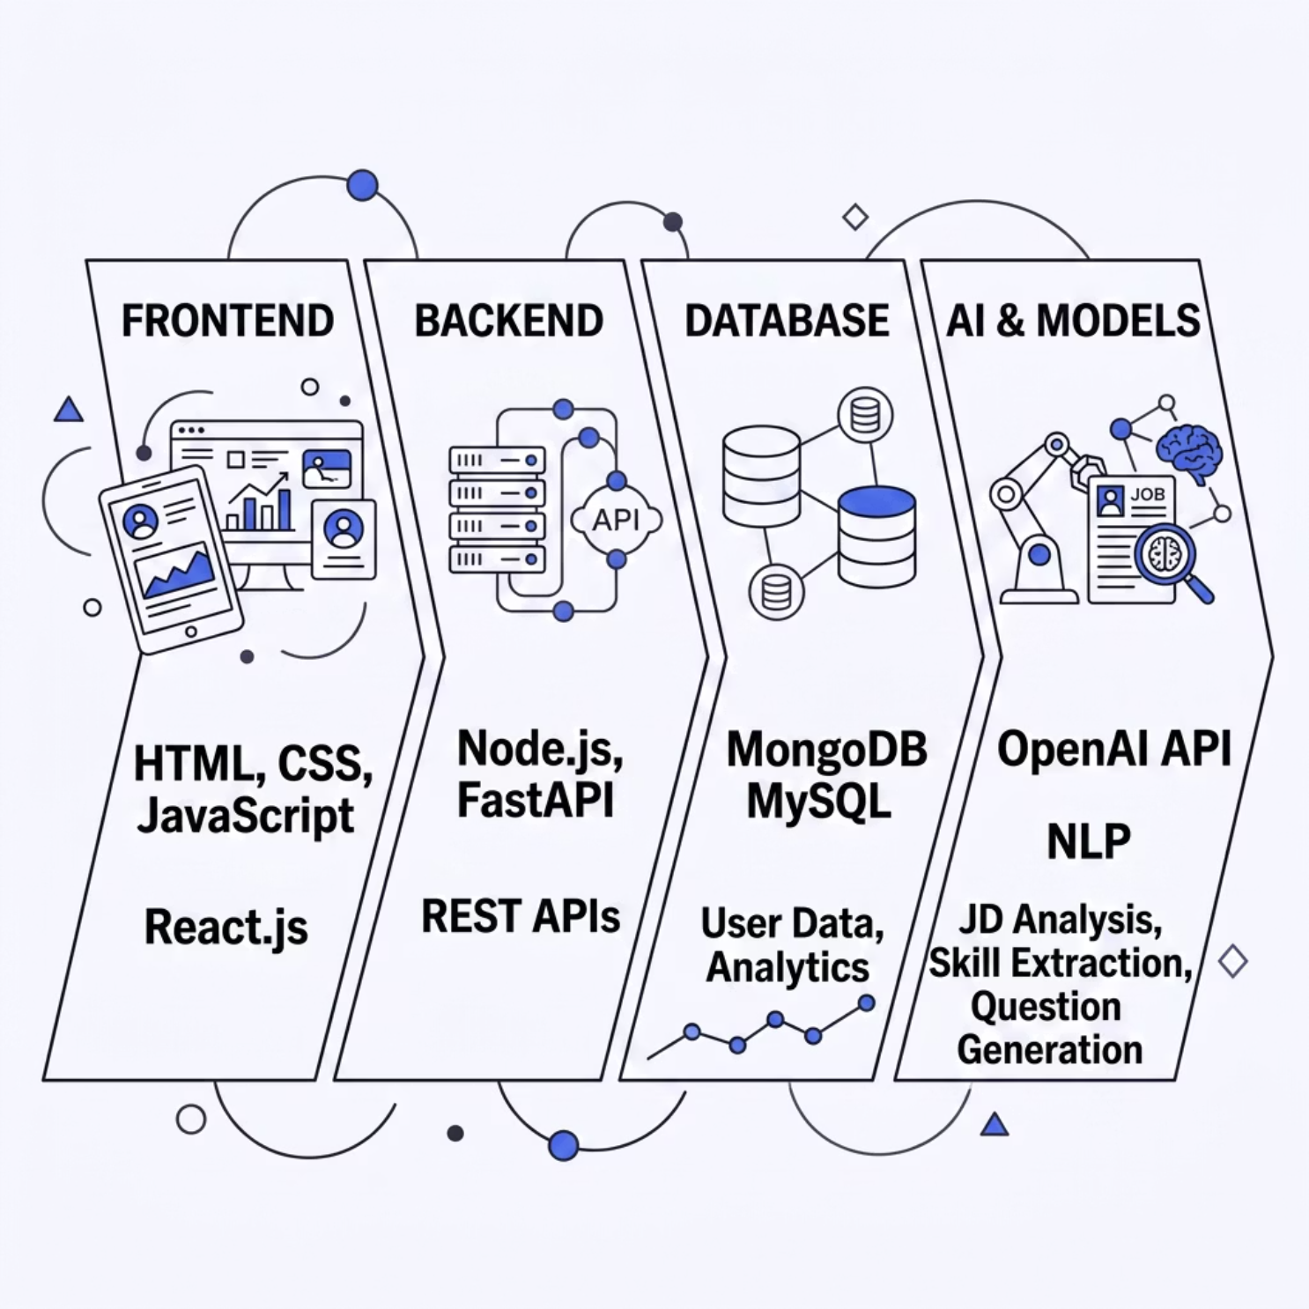

Methodology & Tech Stack
Built on an Agile Development Methodology with iterative sprints, continuous testing, and phased deployment.
Development & Deployment Tools
GitHub
Version control and team collaboration
Postman
API testing and endpoint validation
Docker
Optional containerization for scalable deployment

Slide 5
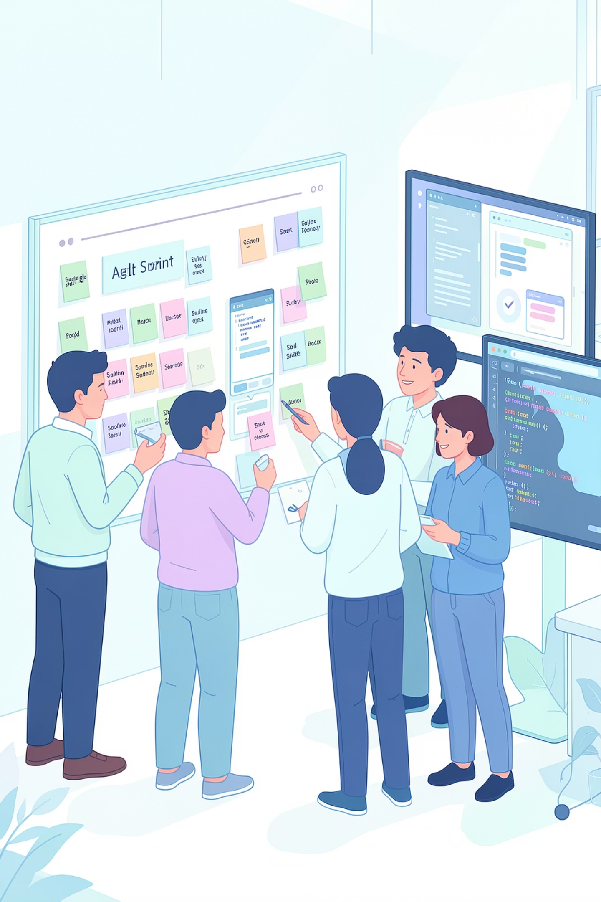
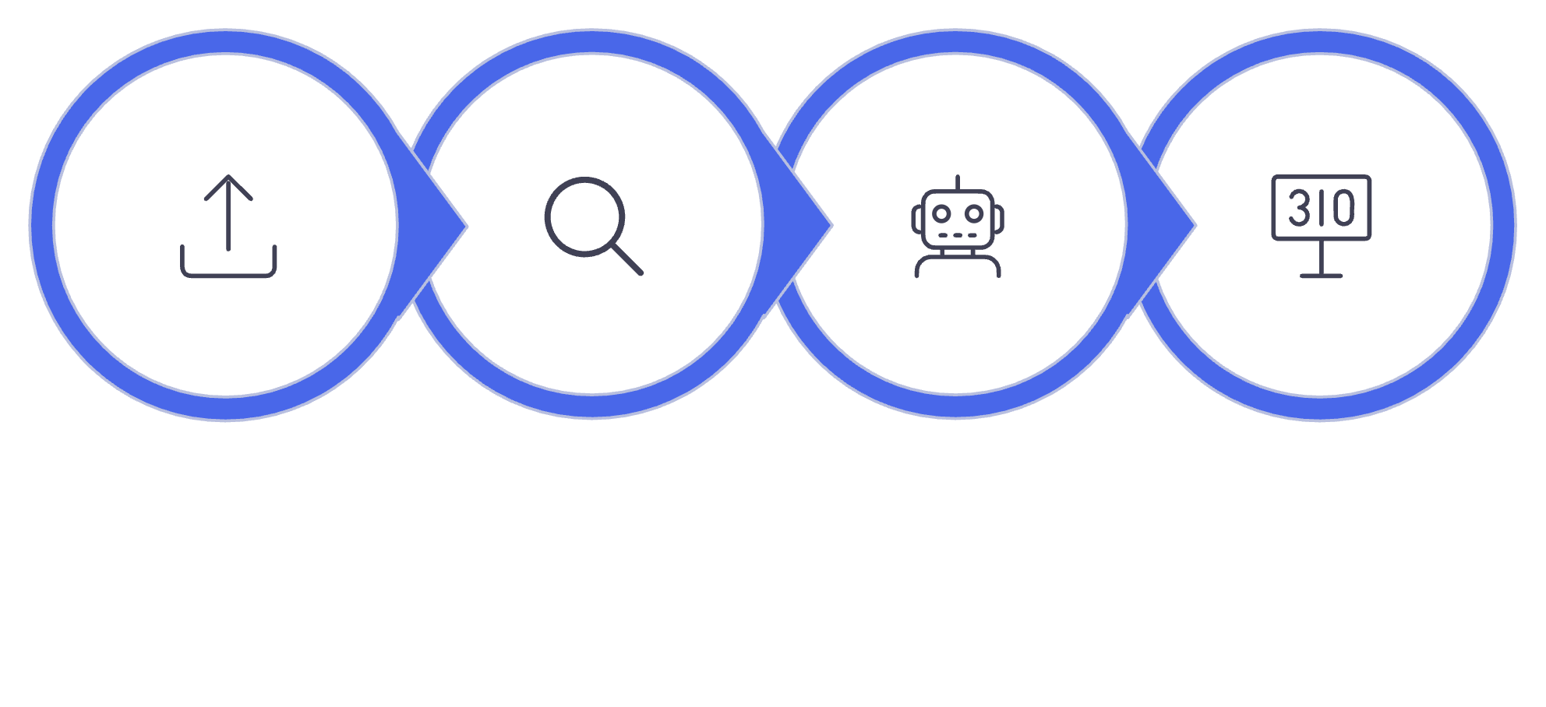
System Architecture Overview
Job Upload
Skill Extraction
Question Generation
Candidate Scoring
Each layer communicates via REST APIs, ensuring a modular, scalable architecture that can evolve with new AI capabilities.

Slide 6
Module Implementation Progress
✅ Completed Modules
🔄 In Progress
User Authentication & Profile Management
Job Description Upload and Parsing
AI-based Question Generation
Technical & HR Interview Simulation
Coding Round Evaluation System
Feedback Dashboard with Performance Analytics
AI response optimization
Coding evaluation module testing
Dashboard analytics refinement
⏳ Pending
Advanced AI feedback enhancement
Voice/video interview integration
Performance optimization & deployment testing

Slide 7
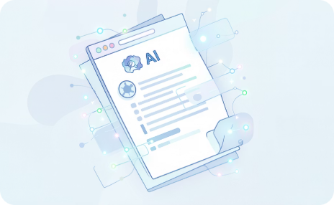
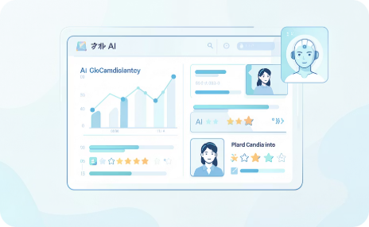
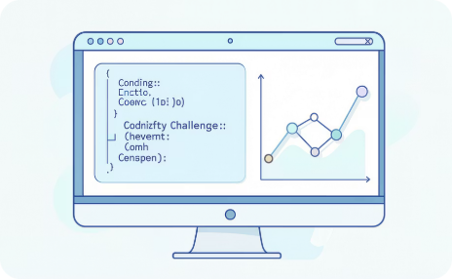
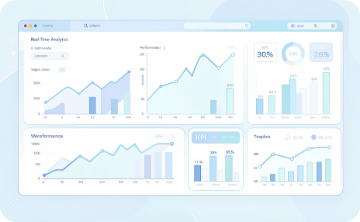
Innovation Highlights
JD-Driven Personalization
AI Evaluation & Scoring
Coding Assessment
Real-Time Analytics
Automated coding round evaluation with complexity and correctness analysis built in.
Live performance tracking across sessions, enabling candidates to monitor growth over time.
Interview questions generated dynamically from the candidate's actual target Job Description — not templates.
Automated candidate assessment with role-specific benchmarks and actionable improvement suggestions.

Slide 8
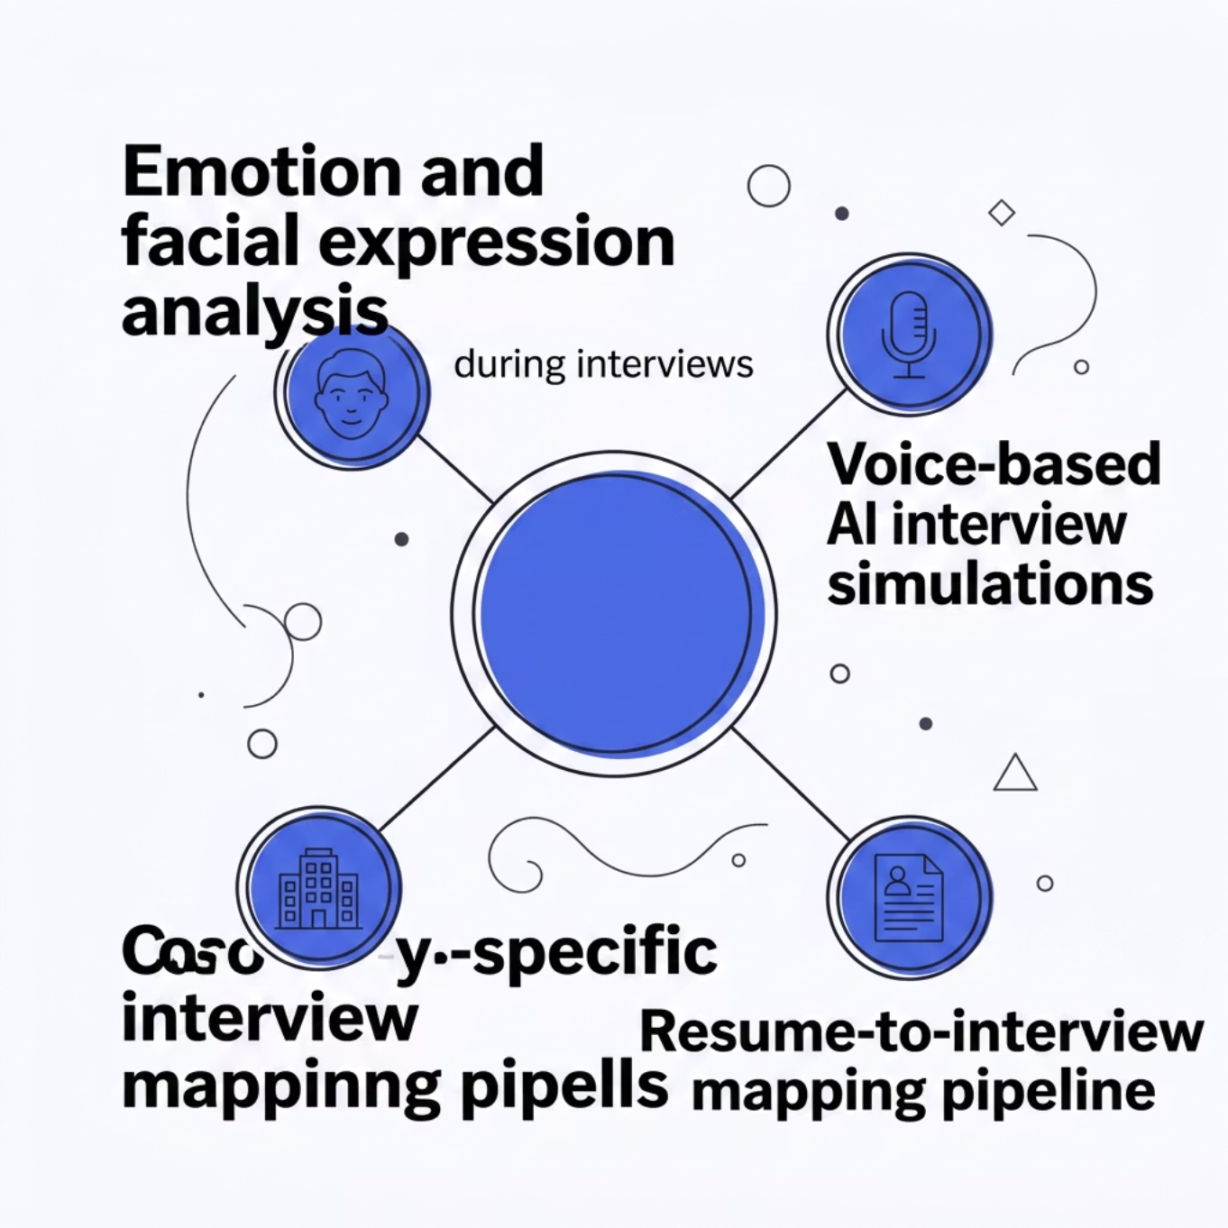

Research Contribution & Publication Scope
Where This Research Is Headed
This project sits at the intersection of Artificial Intelligence and EdTech — a rapidly growing space with high publication and patent potential.
📄 Research Paper
🎤 Conference
🔐 Patent
AI/EdTech domain journals and conferences
Intelligent interview systems presentation
Provisional filing on AI-personalized interview methodology

Slide 9
Presentation & Live Demo Strategy
01
02
03
Problem & Motivation
Architecture & Stack
Live Simulation Demo
Set the stage with the gap in current platforms and why this solution matters.
Walk through the system design, technology choices, and rationale.
Demonstrate a real JD upload, question generation, and AI evaluation in action.
04
05
Analytics Dashboard
Q&A & Future Scope
Showcase feedback reports and performance tracking features.
Address queries confidently, emphasizing scalability, innovation, and real-world impact.

Slide 10

Key Takeaways
Real Personalization
Full-Stack AI
Job Description analysis creates a uniquely tailored experience for every candidate.
From NLP parsing to automated scoring — AI is embedded at every layer of the platform.
Research-Ready
Built to Scale
Positioned for publication, conference presentation, and provisional patent filing.
Modular architecture and Docker-ready deployment ensure the platform grows with demand.
This platform doesn't just prepare candidates — it redefines what interview readiness looks like in the age of AI.

